Slide 1
Future of the electrochemisty
Fyodor Malchik

Slide 2
Introduction
Nanotechnology =
the emerging technology with enormous potential for
Information and Communication ICT
Technology ,biology and biotechnology,
Medicine and medical technology
Nanobiotechnology= The convergence of recent advances in nanotechnology with modern biology and medicine has created the new research domain
❖
Nanomedicine =The use of nanobiotechnology in medicine
2
Title of Meeting, Date, Location

Slide 3
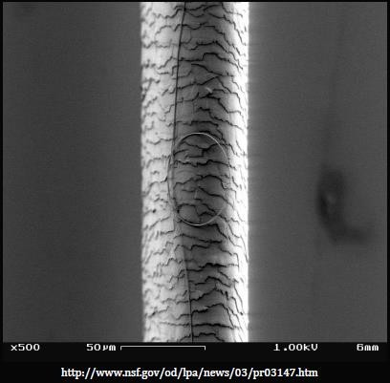
What is a nano
What is 100,000 times thinner than a strand of
hair &
20 times tougher than
steel ? A Carbon nano tube CNT
1x10-9 m
3

Slide 4
What is nanotechnolgy
Nanotechnology is not biology, physics or chemistry, its all sciences that deal with such a small scale
Best definition : ncompesses the common unifying concept & physical laws that privail in the Nano scale
www.nanoscience- europe.org
4

Slide 5
What is nanomedicine
Nanomedicine may be better defined as :
„The monitoring, repairing and construction of human biological systems at the molecular level
using engineered Nanodevices and Nanostructures”
Nanomedicine Roadmaps towards 2020 http//www.foresight.org/Nanomedicine
5

Slide 6
Definitions
Nanomaterials and biological structures are of the same size, which allows for unique interactions between biological systems and synthetic materials for analytical, diagnostic and therapeutic applications
Nanomedicine The use of materials whose components exhibit significantly changed properties by gaining control of structures at the atomic, molecular, and supramolecular levels.
Novel nano- and bio-materials as well as nanodevices are fabricated and controlled by nanotechnology tools and techniques, which investigate and tune properties,responses and functions of living and non-living matter at
sizes below < 100 nm.
6
Title of Meeting, Date, Location

Slide 7
Nanomedicine focused topics
Engineering Topics including Peptide nanoparticles for medical applications, the
Transition from semiconductors to biochemistry in the lithography
industry;Topics in Clinical Applications i.e. nanomedicine and protein mis. diseases Topics in genetics (e.g. Nanostructured probes for gene detection in living cells, Detecting UV damage to individual DNA molecules with Atomic Force Microscopy, Topics in Diagnostics, with its main focus on early diagnosis in vitro and in vivo; Policy and Commercialization Topics, including initiative in nanomedicine to focus efforts in research, development and applied nanotechnology for improving the diagnostics, therapeutics and treatment of cancer;
Experimental Research Topics,-main basis for preclinical study, like Nanodiagnostic
imaging;Topics on Basic Nanomedicine,
Topics on Pharmacology;
Topics on Oncology and Toxicology.
7
Title of Meeting, Date, Location

Slide 8
Nanomedicine application domains(1)
Diagnostics main objectives of development:
-Devices for combined structural and functional imaging in vivo
-Portable point of care devices (POC)
-Devices for multiparameter (multiplexing) measurement
-Devices for monitoring therapy and personalised medicine
Magnetic particles Imaging
Magnetic particles for drugs targeting
Targeted therapy and drugs release
Molecular optical imaging

Slide 9
Nanomedicine application domains(2)
Drug delivery / Nanopharmaceuticals
Noninvasive delivery of protein nanomadicine Noninvasive delivery DNA based nanomedicine Therapeutic nanaoparticles and polymers Nanocarrrier and transporter molecules and particle Computational tools
Nanodevices
Focused ultrasound therapy system Pressure and thermosensitive drugs Targeted therapy in Oncology Antiinflamatory diseases

Slide 10
Nanomedicine application domains(3)
Regenerative medicine
Smart biomaterials Nanorchitectured EMA
Synthetic prophorgens
High throughout nanoscreening devices
Cues delivery shapers
Cells theraphy Delivery vehicles
Tissue Engineered Producvts (i.e Heart tissues ! )
Cells (Parkinson ,Alzheimer,Huntington ds,cardiac,retinal,diabet,spinal cord )
In vitro assays and bioreactors

Slide 11
Biomedical applications of Nanobiosensors
The terms ‘‘nanoscience’’ or ‘nanotechnology’’ are best used for phenomenon associated with structures approximately 1-100 nm in size where the properties of interest are due to the size of the structure
„The design, characterization, production, and application of structures, devices and systems by controlled manipulation of size and shape at the nanometer scale that produces structures, devices and systems with at
least one novel/superior characteristic or property”

Slide 12
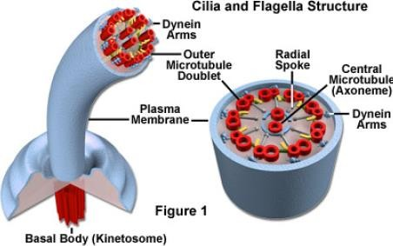
Nanotechnology in nature
When it comes to nature,they are the king of nanotechnology
A flagelia structure is a complexity of nanorotors,motors tubes & arms
that works better together, many of which we still try to decipher how they work
http//wwww.micro.magnet.fsu.edu//cells/cilliandflagella/ciliandflagella.html

Slide 13
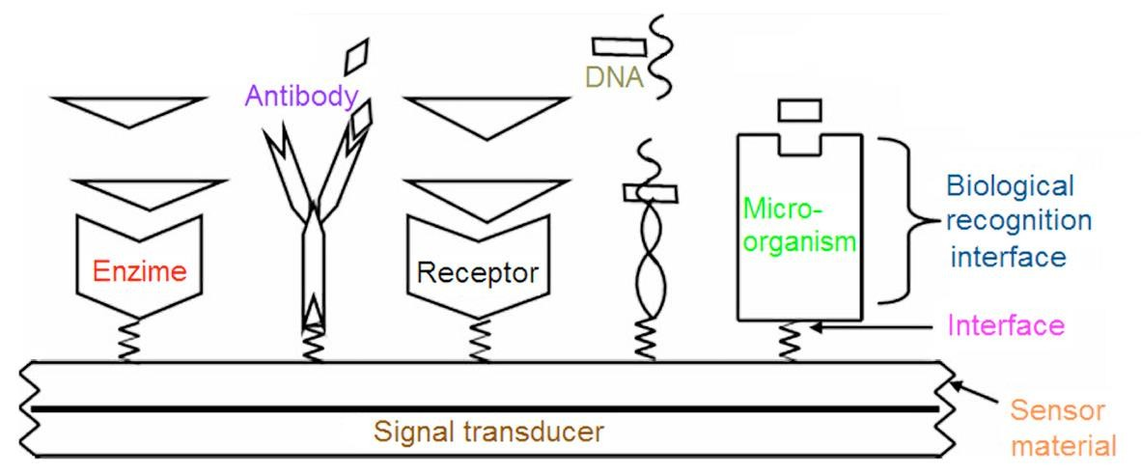
Schematic representation of nanobiosensor components

Slide 14
Potential fields

Slide 15
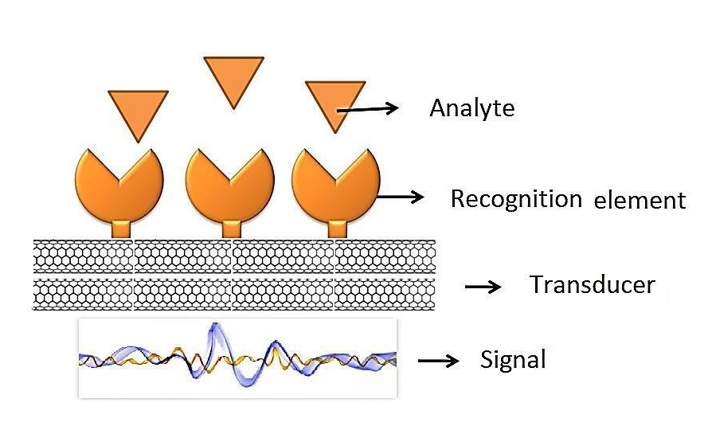
Schematic presentation of a biosensor.
Biosensors
are the detection of
devices for
biological analytes
which
have wide applications, including biomarker dete- ction for medical diagnostics, and pathogen and toxin detection in a
specimen analyte on surface
by binding the reactive
16
Title of Meeting, Date, Location
Nanogentools confidential

Slide 16
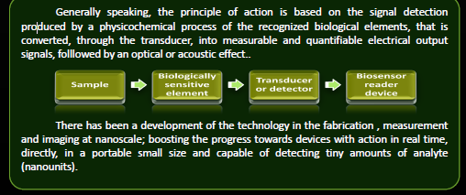
The nanobiosensor principle of operation

Slide 17
Sensing techniques
The sensing techniques can detect the interaction between bio-receptors and target compounds using different appropriate nanostructures
The two principal components of biosensors are :
biological element and a transducer.
The biological element interacts with an analyte to produce a detectable change.
The transducer converts the physico-chemical change in the biologically active material resulting from the interaction with the analyte into an analytical useful / measurable signal
According to the transducers, the biosensors can be classified as
(i) electrochemical, (ii) optical, and
(iii) piezoelectric biosensors.

Slide 18
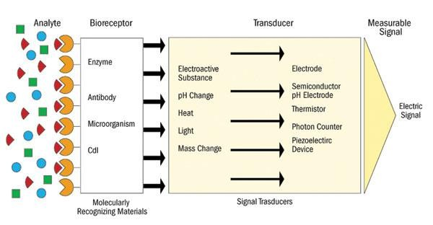
What is a biosensor ?

Slide 19
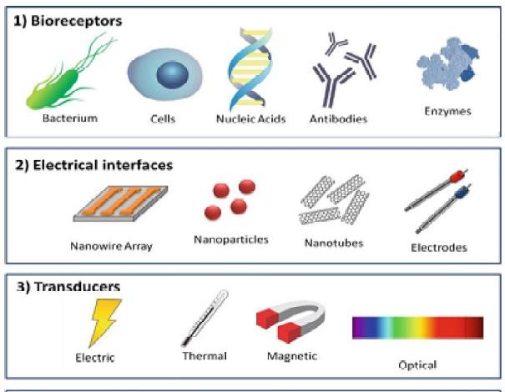
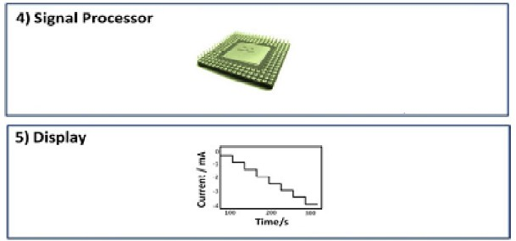
The components of a typical biosensor.

Slide 20
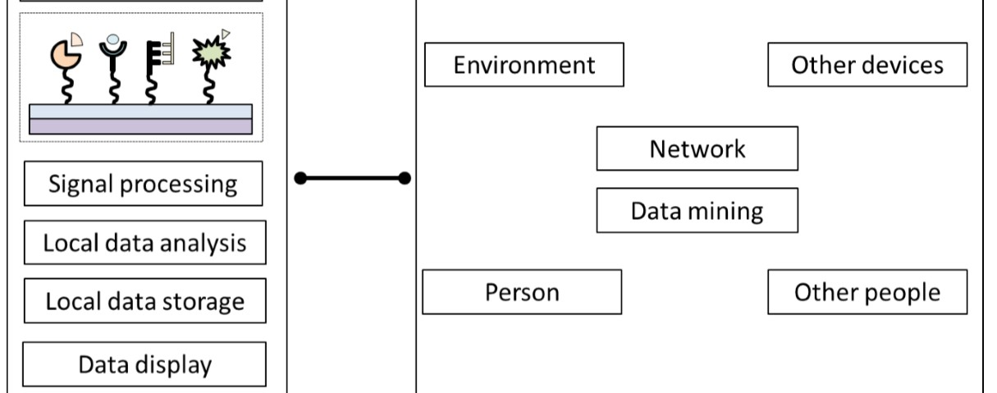
Biosensing operation system

Slide 21
Electrochemical nanobiosensors
Electrochemical methods of interest worldwide and remarkable advantages:
high sensitivity,
small dimensions,
low-interference characteristics,
low cost, and compatibility with microfabrication technology
Depending upon the electrochemical property to be measured by a detector system, electrochemical biosensors can be divided into four sub-categories
potentiometric,
amperometric,
conductometric, and
impedimetric biosensors

Slide 22
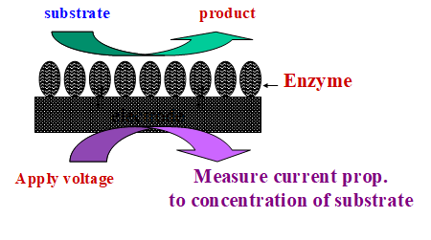
Electrochemical biosensors
Electrochemical biosensors are mainly based on the fact that during a bio-interaction process, electrochemical species such as electrons are consumed or generated producing an physically readable electronic signal which can be recorded by applying different electro-chemical detections.
Electrochemical property to be measured by
a detector system,
allows to be divided into four sub-categories
potentiometric,
amperometric,
conductometric, and
impedimetric biosensors
Principle of Electrochemical Biosensors

